Slide 1


Vidit Sharma
26th July 2022

Slide 2
Executive Summary
Introduction
Methodology
Results
Conclusion
Appendix
Outline

Slide 3
Summary of methodologies
Data Collection through API
Data Collection with Web Scraping
Data Wrangling
EDA with SQL
EDA with Data Visualization
Interactive Visual Analytics with Folium lab
Machine Learning Prediction
Summary of all results
Data Collection and EDA result
Machine Learning Prediction provided the best model to predict the outcome
Executive Summary

Slide 4
Project background and context
In this capstone, we will predict if the Falcon 9 first stage will land successfully. SpaceX advertises Falcon 9 rocket launches on its website with a cost of 62 million dollars; other providers cost upward of 165 million dollars each, much of the savings is because SpaceX can reuse the first stage. Therefore, if we can determine if the first stage will land, we can determine the cost of a launch. This information can be used if an alternate company wants to bid against SpaceX for a rocket launch.
Problems you want to find answers
What factors determine if the rocket will land successfully?
What are the best places to make a launch?
Introduction

Slide 5

Section 1

Slide 6
Executive Summary
Data collection methodology:
Data was collected using SpaceX API and from web scraping from Wikipedia.
Perform data wrangling
perform some Exploratory Data Analysis (EDA) to find some patterns in the data.
Perform exploratory data analysis (EDA) using visualization and SQL
Perform interactive visual analytics using Folium and Plotly Dash
Perform predictive analysis using classification models
Training Data is used to build, tune, evaluate classification models on the Testing Data.
Methodology

Slide 7
Data Collection
Data was collected using two methods:
Using SpaceX API
https://api.spacexdata.com/v4/rockets/
Web Scraping from Wikipedia

Slide 8
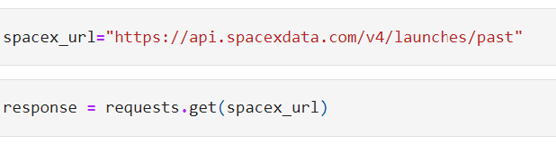
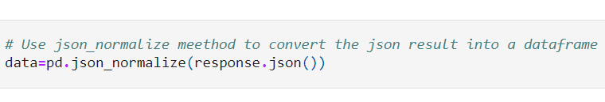
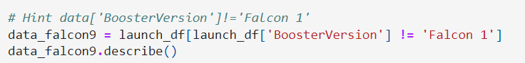
Data Collection – SpaceX API
Present your data collection with SpaceX REST calls using key phrases and flowcharts
GitHub URL: https://github.com/vidit-sharma/IBM-Data-Science-Capstone/blob/master/1.%20Data%20Collection%20API.ipynb

Slide 9
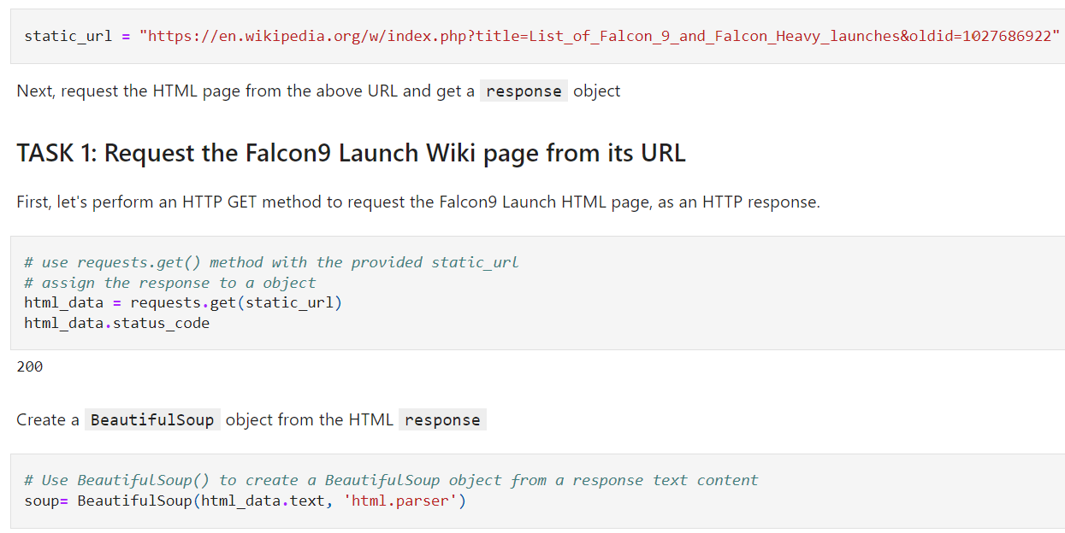
Data Collection - Scraping
We applied web scrapping to web-scrap Falcon 9 launch records with Beautiful Soup.
GitHub URL: https://github.com/vidit-sharma/IBM-Data-Science-Capstone/blob/master/2.%20Data%20Collection%20with%20Web%20Scraping.ipynb

Slide 10

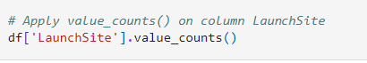
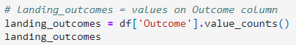
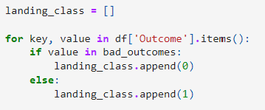
Data Wrangling
We perform some Exploratory Data Analysis (EDA) to find some patterns in the data and determine what would be the label for training supervised models.
GitHub URL: https://github.com/vidit-sharma/IBM-Data-Science-Capstone/blob/master/3.%20Data%20Wrangling.ipynb

Slide 11
EDA with Data Visualization
We explored the data by visualizing the relationship between flight number and launch Site, payload and launch site, success rate of each orbit type, flight number and orbit type, the launch success yearly trend.
GitHub URL: https://github.com/vidit-sharma/IBM-Data-Science-Capstone/blob/master/5.%20EDA%20with%20Data%20Visualization.ipynb

Slide 12
EDA with SQL
We applied EDA with SQL to get insight from the data. We wrote queries to find out for instance:
The names of unique launch sites in the space mission.
The total payload mass carried by boosters launched by NASA (CRS)
The average payload mass carried by booster version F9 v1.1
The total number of successful and failure mission outcomes
The failed landing outcomes in drone ship, their booster version and launch site names.
GitHub URL: https://github.com/vidit-sharma/IBM-Data-Science-Capstone/blob/master/4.%20EDA%20with%20SQL.ipynb

Slide 13
Build an Interactive Map with Folium
Markers, circles, lines and marker clusters were used with Folium Maps
Markers indicate points like launch sites.
Circles indicate highlighted areas around specific coordinates, like NASA Johnson Space Center.
Marker clusters indicates groups of events in each coordinate, like launches in a launch site
Lines are used to indicate distances between two coordinates.
GitHub URL: https://github.com/vidit-sharma/IBM-Data-Science-Capstone/blob/master/6.%20Interactive%20Visual%20Analytics%20with%20Folium%20lab.ipynb

Slide 14
Predictive Analysis (Classification)
We loaded the data using numpy and pandas, transformed the data, split our data into training and testing.
We built different machine learning models and tune different hyperparameters using GridSearchCV.
We used accuracy as the metric for our model, improved the model using feature engineering and algorithm tuning.
We found the best performing classification model.
GitHub URL: https://github.com/vidit-sharma/IBM-Data-Science-Capstone/blob/master/7.%20Machine%20Learning%20Prediction.ipynb

Slide 15
Exploratory data analysis results
Interactive analytics demo in screenshots
Predictive analysis results
Results

Slide 16

Section 2

Slide 17
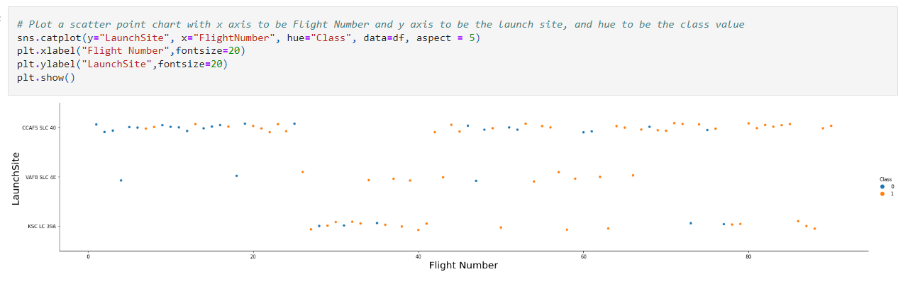
Flight Number vs. Launch Site
Flight Number vs. Launch Site

Slide 18
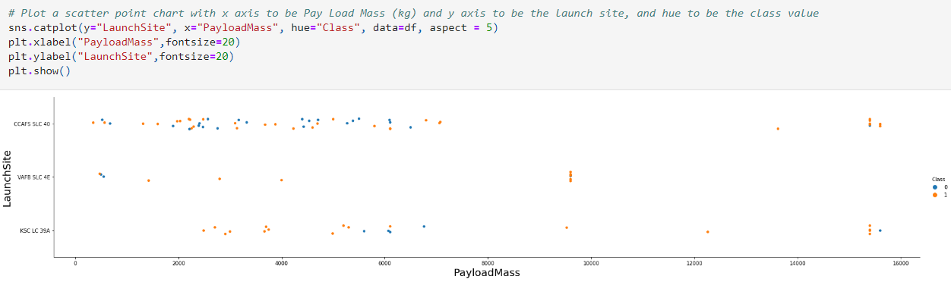
Payload vs. Launch Site
Payload vs. Launch Site

Slide 19
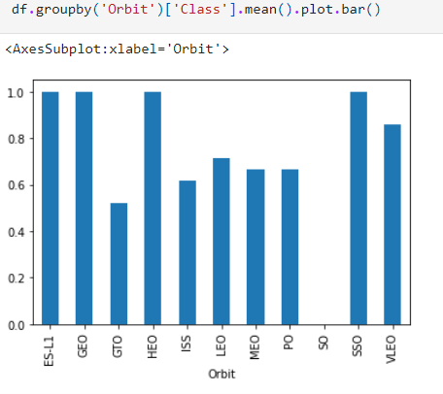
Success Rate vs. Orbit Type
Success rate of each orbit type

Slide 20
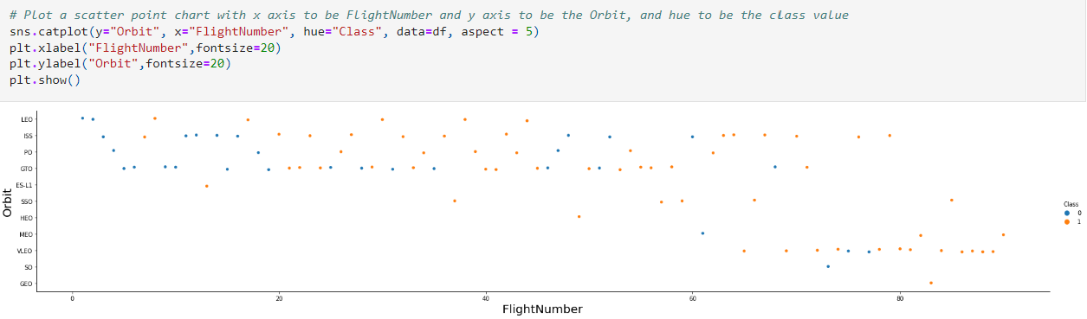
Flight Number vs. Orbit Type
Flight number vs. Orbit type

Slide 21
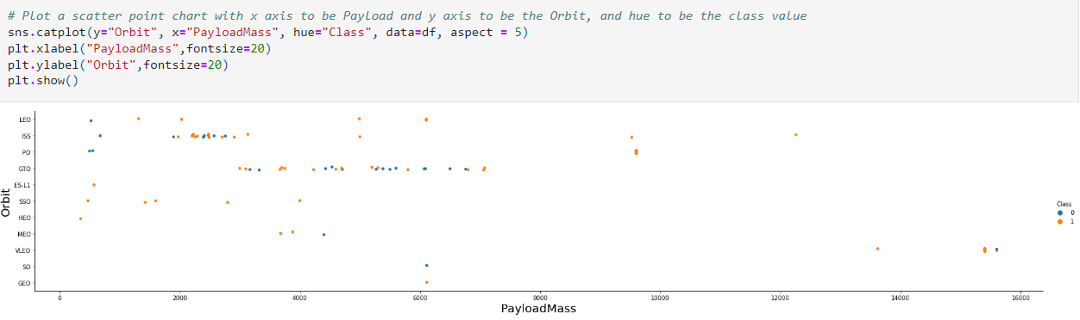
Payload vs. Orbit Type
payload vs. orbit type

Slide 22
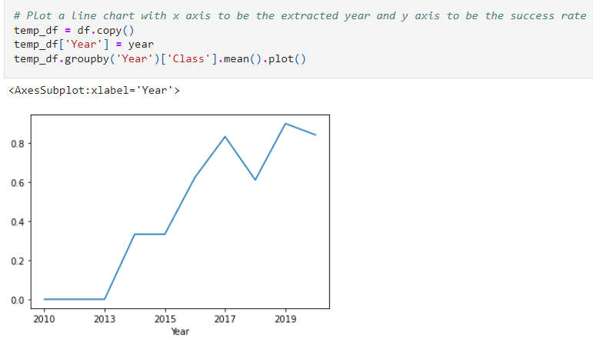
Launch Success Yearly Trend
Yearly average success rate

Slide 23
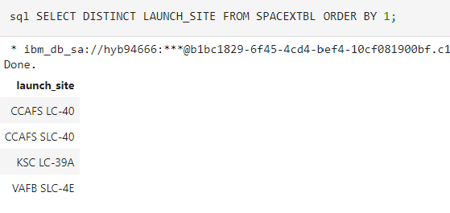
All Launch Site Names

Slide 24
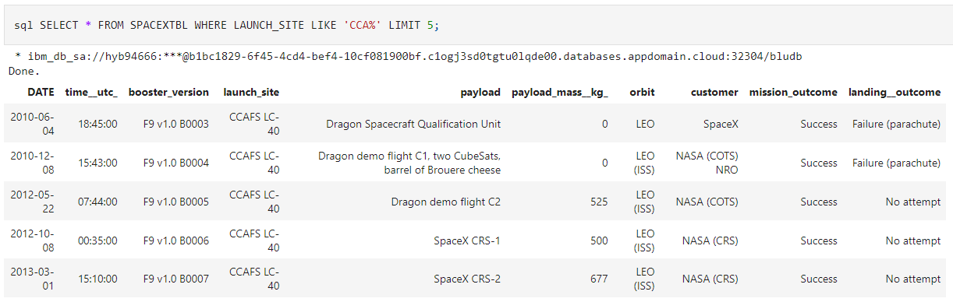
Launch Site Names Begin with 'CCA'

Slide 25
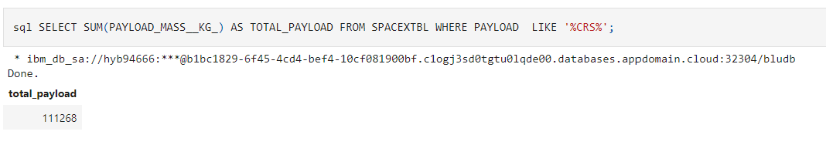
Total Payload Mass

Slide 26
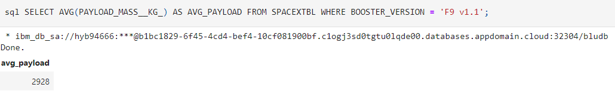
Average Payload Mass by F9 v1.1

Slide 27
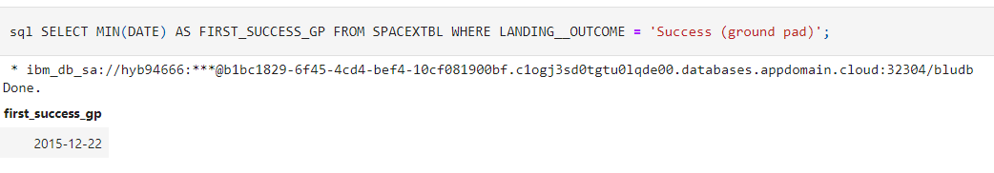
First Successful Ground Landing Date

Slide 28
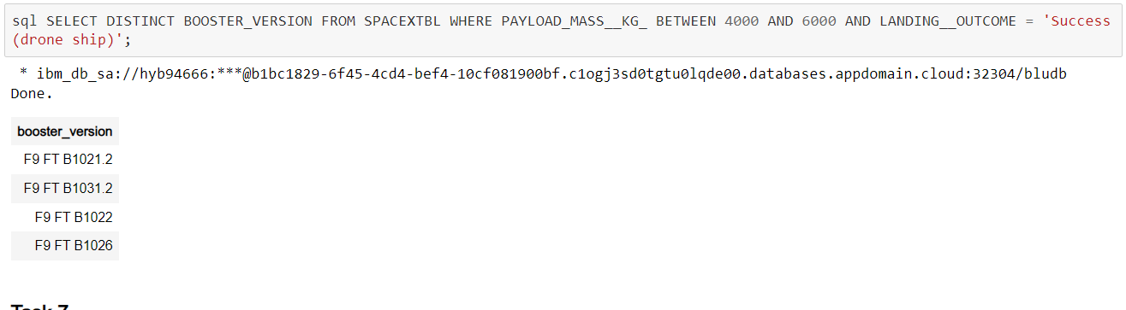
Successful Drone Ship Landing with Payload between 4000 and 6000

Slide 29
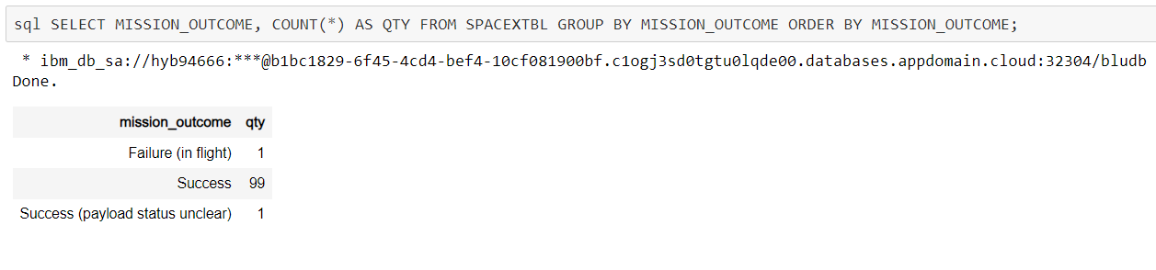
Total Number of Successful and Failure Mission Outcomes

Slide 30
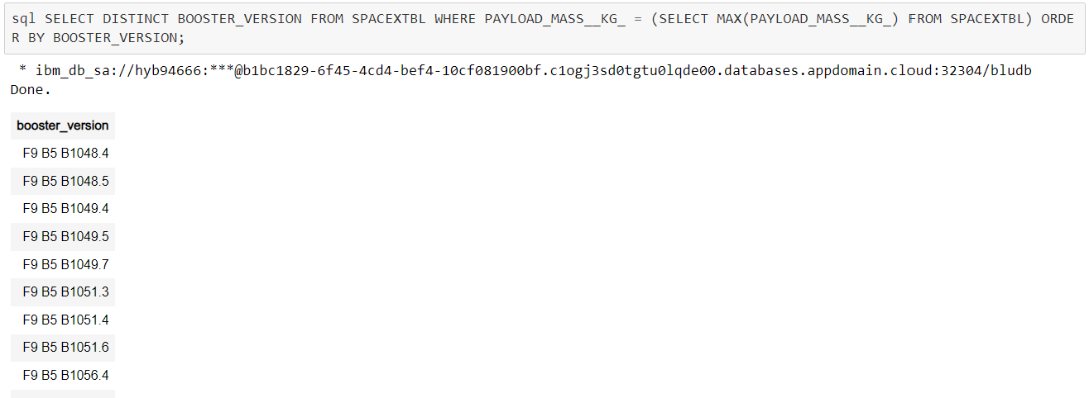
Boosters Carried Maximum Payload

Slide 31
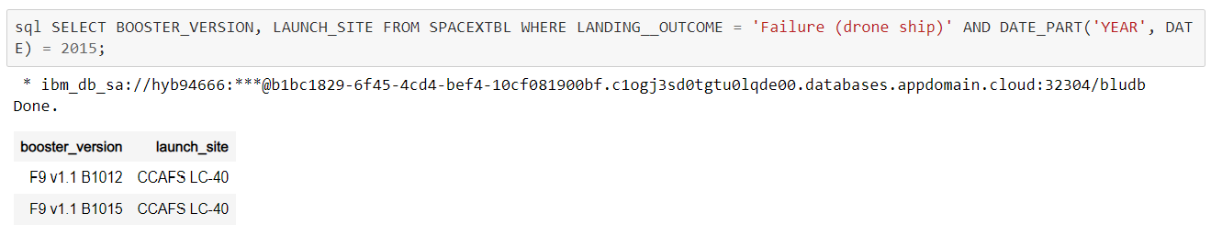
2015 Launch Records

Slide 32
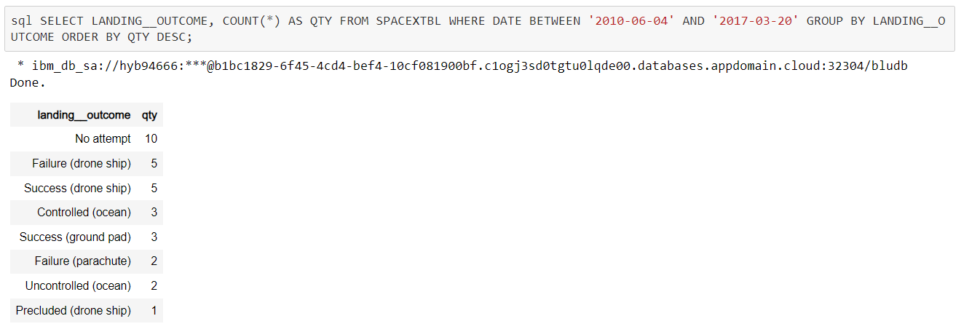
Rank Landing Outcomes Between 2010-06-04 and 2017-03-20

Slide 33

Section 3

Slide 34

All launch sites US map markers

Slide 35

Section 4

Slide 36
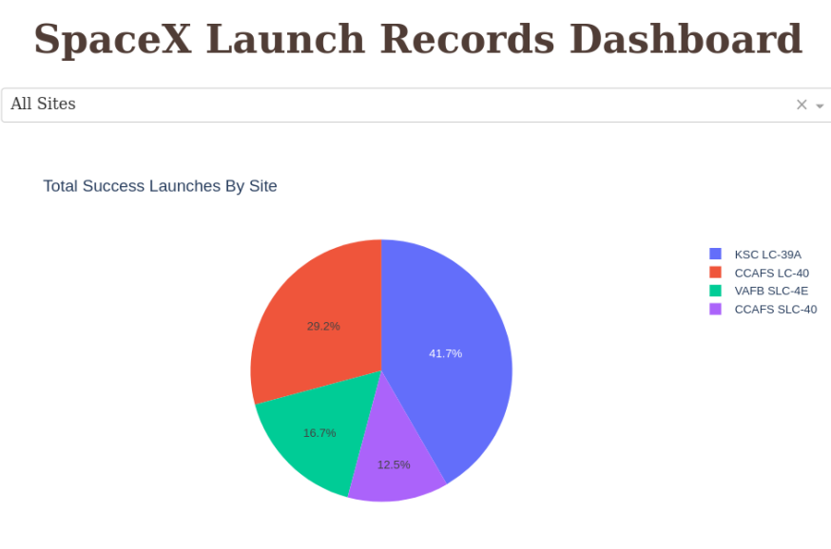
SpaceX Launch Records Dashboard

Slide 37
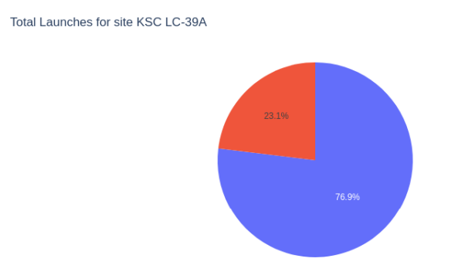
Launch Success Ratio for KSC LC-39A

Slide 38

Section 5

Slide 39
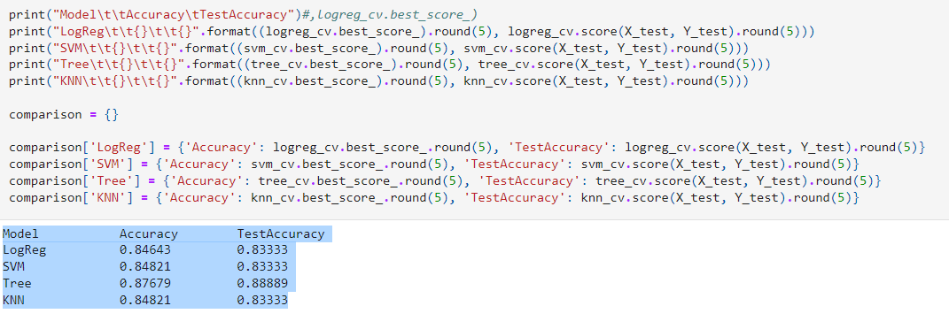
Classification Accuracy

Slide 40
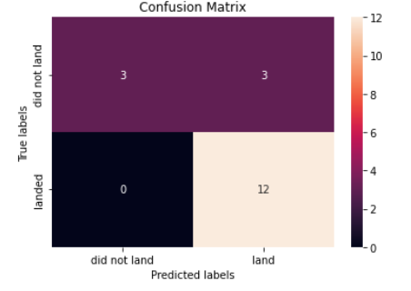
Confusion Matrix

Slide 41
Conclusions
We can conclude that:
The larger the flight amount at a launch site, the greater the success rate at a launch site.
Launch success rate started to increase in 2013 till 2020.
Orbits ES-L1, GEO, HEO, SSO, VLEO had the most success rate.
KSC LC-39A had the most successful launches of any sites.
The Decision tree classifier is the best machine learning algorithm for this task.

Slide 42
Appendix
GitHub URL: https://github.com/vidit-sharma/IBM-Data-Science-Capstone.git

Slide 43


